Slide 1


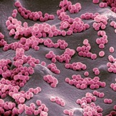

Multivariate Analyses of Microbial Communities
Thursday 7th October

Slide 2
Goals of Next Two Days
Explore the huge variety of statistical tests available for the interrogation of microbial community data
Gain experience of choosing and using these tests within the R computing language
Be aware of the limits and pitfalls of using these tests on particular microbial datasets

Slide 3




Microbial Communities Analysis Workflow
1
Raw
Sequences
BIOINFORMATICS
2
Quality
Trimming
3
4
5
DOWNSTREAM ANALYSIS
Dereplicate &
Denoise
Chimera
Detection
Taxonomy
Assignment

Slide 4
Microbial Communities Analysis Workflow
1-5
8
BIOINFORMATICS
Alpha
Diversity
T tests, GLMs,
GLMMS
7
Rarefied
Libraries
9
Beta
Diversity
Heatmaps, PERMANOVA, Ordinations,
Divergence, Indicator Analysis
6
Quality
Filtering
CLR-
Transformations
10
Unrarefied
Libraries
11
Differential
Abundance
Analysis
DESeq2
ALDEX2

Slide 5
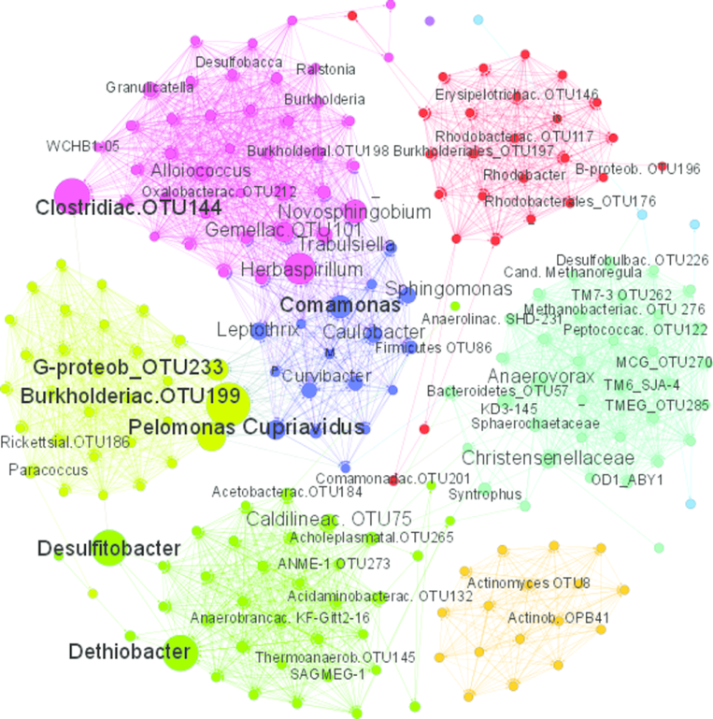
Microbial Communities Are Complex

Slide 6
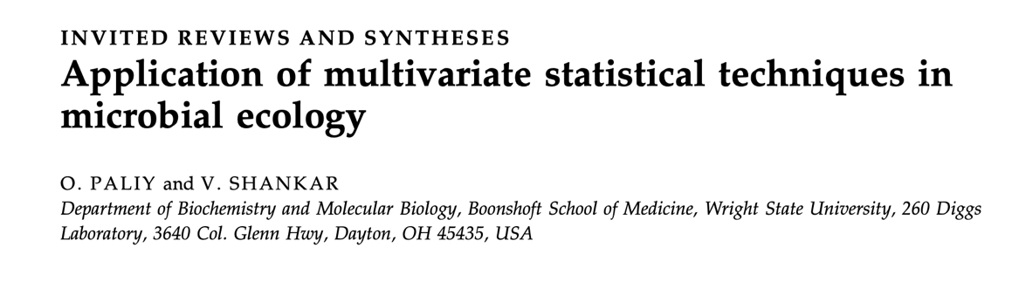

Essential Reading
https://onlinelibrary.wiley.com/doi/abs/10.1111/mec.13536
https://academic.oup.com/femsec/article/62/2/142/434668

Slide 7
Part 1: Alpha Diversity Analysis

Slide 8

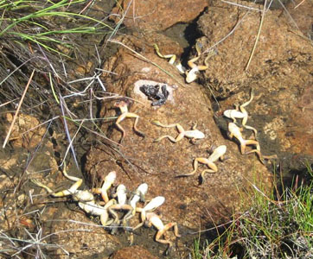

Fungal and Viral Pathogens of Amphibians

Slide 9


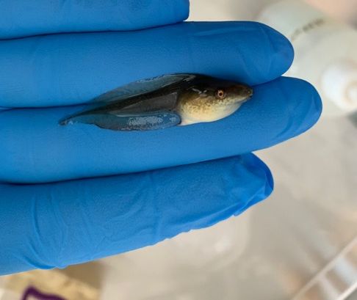


Slide 10
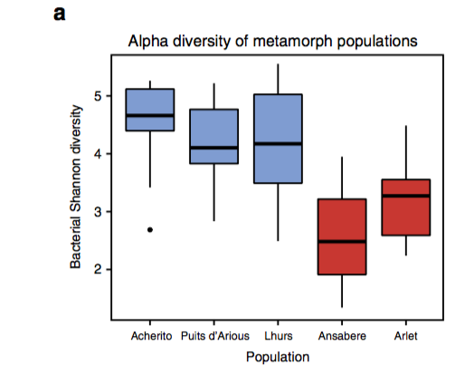
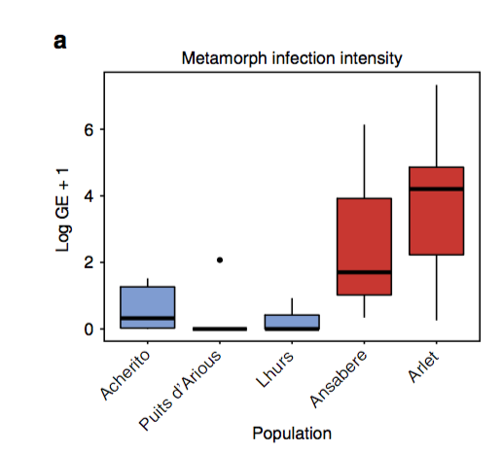
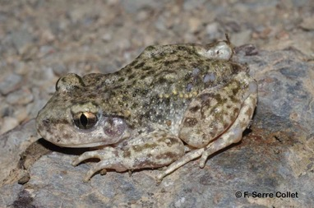
Bates… & Harrison (2018) Nature Communications

Slide 11
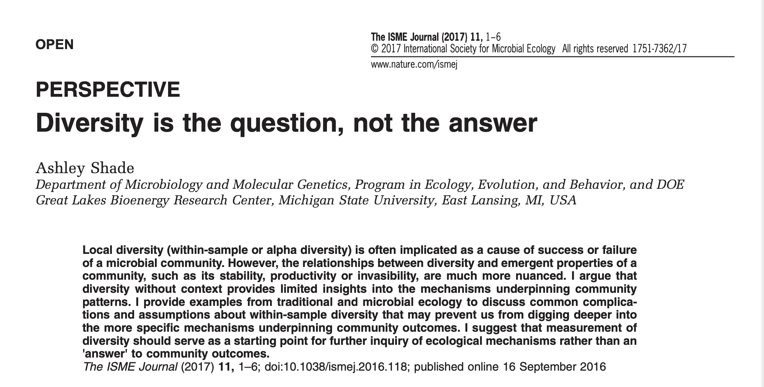
What Are We Measuring?

Slide 12
DIVERSITY METRICS
ACE (Abundance-based Coverage Estimator): weights diversity based on the relative frequency of abundant and rare species
Shannon Diversity: weights diversity based on the relative abundance of community members. In a 2 member community, diversity is highest when the two are in equal proportion
Inverse Simpson: accounts for the weighted mean abundance of all members of a sample - accounts for sample evenness.
Simpson Evenness: The InvSimpson index with denominator scaled to include the total richness of the sample.

Slide 13
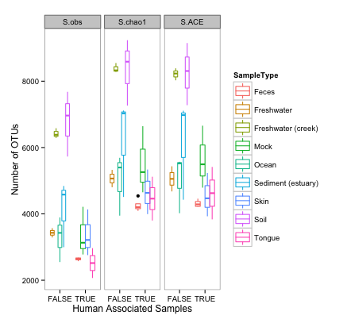
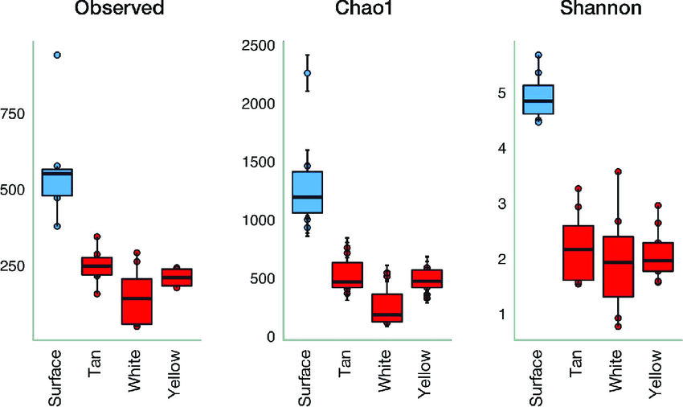
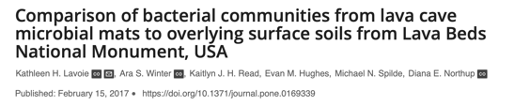
What Are We Measuring?
Alpha diversity metrics are CORRELATED

Slide 14
Analysing Differences in Alpha Diversity
Probably means you will need to use GLMs or GLMMs
How do we choose appropriate error distributions?
Are Alpha Diversity Metrics always normally distributed?
Important to consider the structure of your data

Slide 15
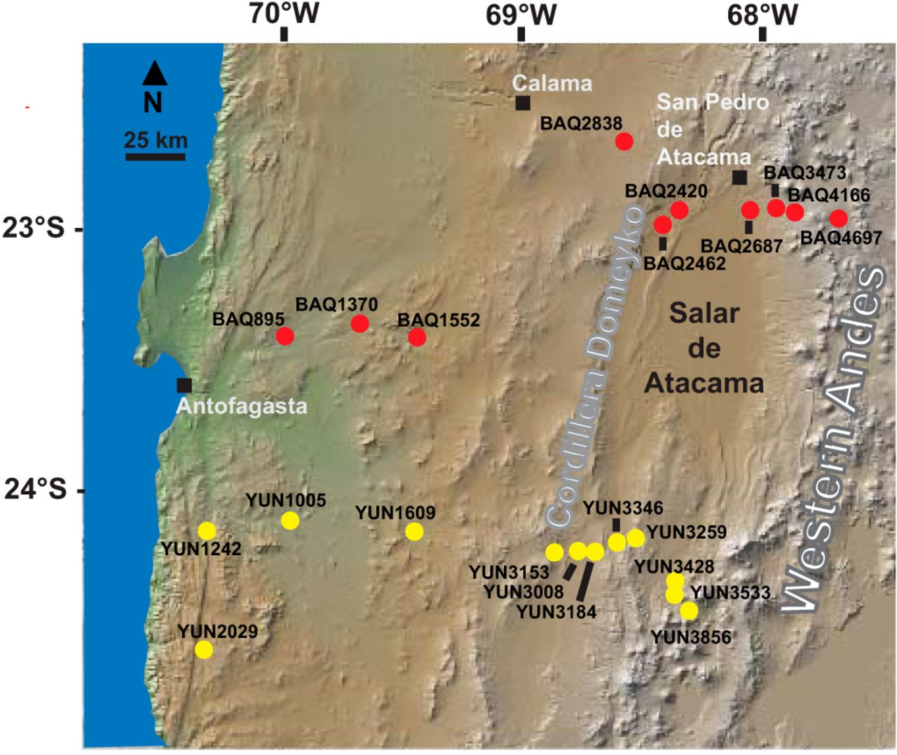
Analysing Differences in Alpha Diversity
Soil Microbial Communities in the Atacama
2 Transects
22 sites (10 & 12)

Slide 16
2 TRANSECTS
MULTIPLE SITES
PER TRANSECT
MULTIPLE SAMPLES
PER SITE
YU1
Sample 1
Our data are
STRUCTURED
YUNGAY
YU2
Sample 2
YUx
Sample x
BA1
BAQUEDANO
BA2
Sample 1
Samples are
not independent
data points
BAx
Sample 2
Sample x

Slide 17
Part 2: Beta Diversity Analysis

Slide 18
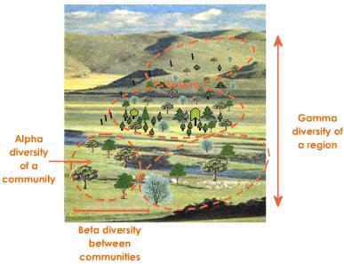
Beta Diversity
We want to understand the differences in microbial community composition among samples and among groups of samples

Slide 19
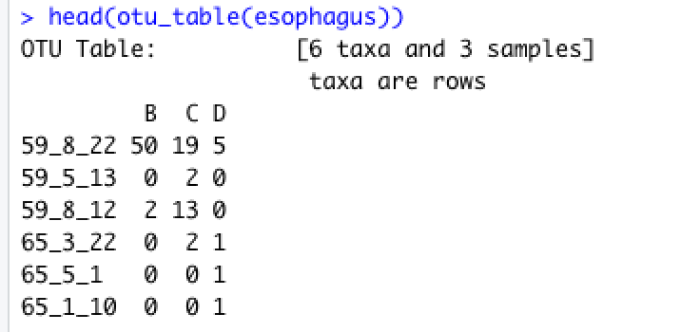
Beta Diversity
We want to understand the differences in microbial community composition among samples and among groups of samples
But how do we summarise microbial communities with potentially hundreds of traits (species) ?

Slide 20
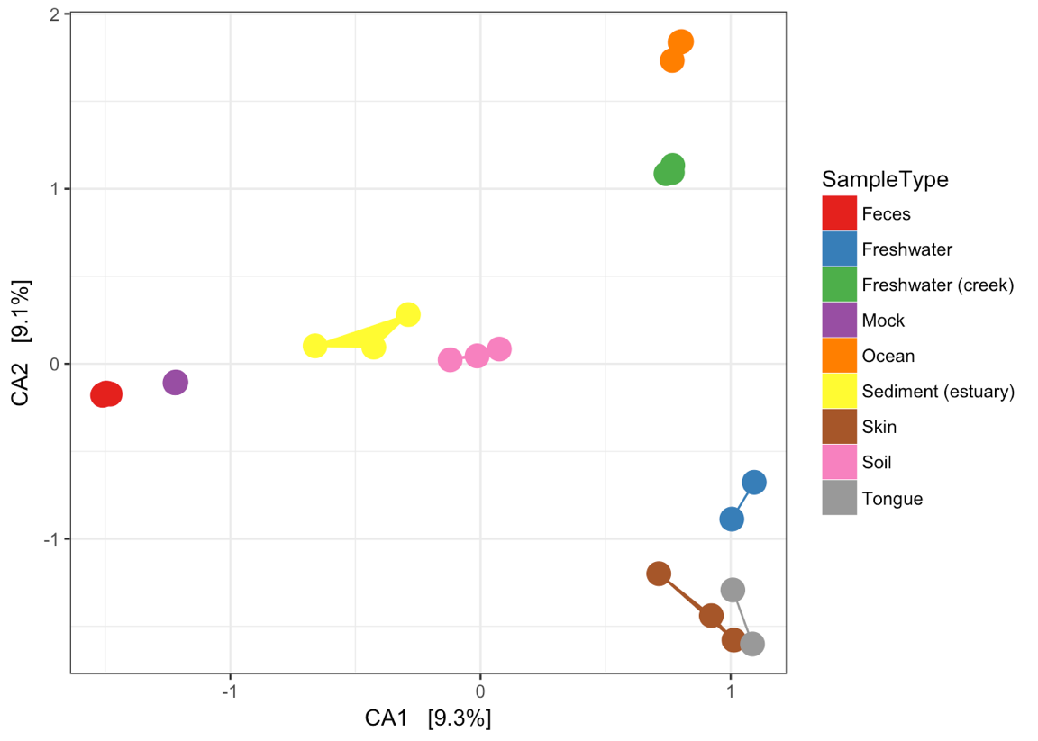
Beta Diversity
To do this, we need
a DISTANCE metric (how dissimilar are samples)
an ORDINATION technique (how do we display those dissimilarities in 2 (ish) dimensions

Slide 21
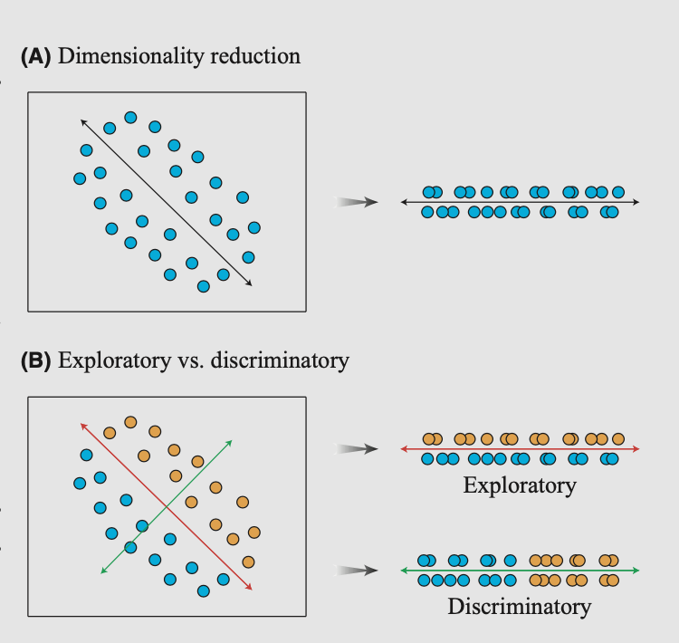
Ordination
Ordination methods like PCA:
Calculate new synthetic variables (principal components), which are linear combinations of the original variables that…
account for as much of the variance of the original data as possible

Slide 22
Ordination Techniques
EXPLORATORY ORDINATIONS:
Principal Coordinates Analysis (PCoA): Like a Principal Component Analysis (PCA) but can use any dissimilarity matrix (Bray-Curtis, UNIFRAC) etc. Can’t handle predictors.
Non-Metric Multidimensional Scaling (NMDS): Unique ordination technique in which you choose number of axes to ordinate to. Rank based approach, not absolute distances. Can’t handle predictors.
INTERPRETIVE ORDINATIONS
Constrained Correspondence Analysis (CCA): Calculates axes that ‘constrain’ variation in distance matrix to that explained by candidate variables, and axes that ordinate variance not explained by those factors.

Slide 23
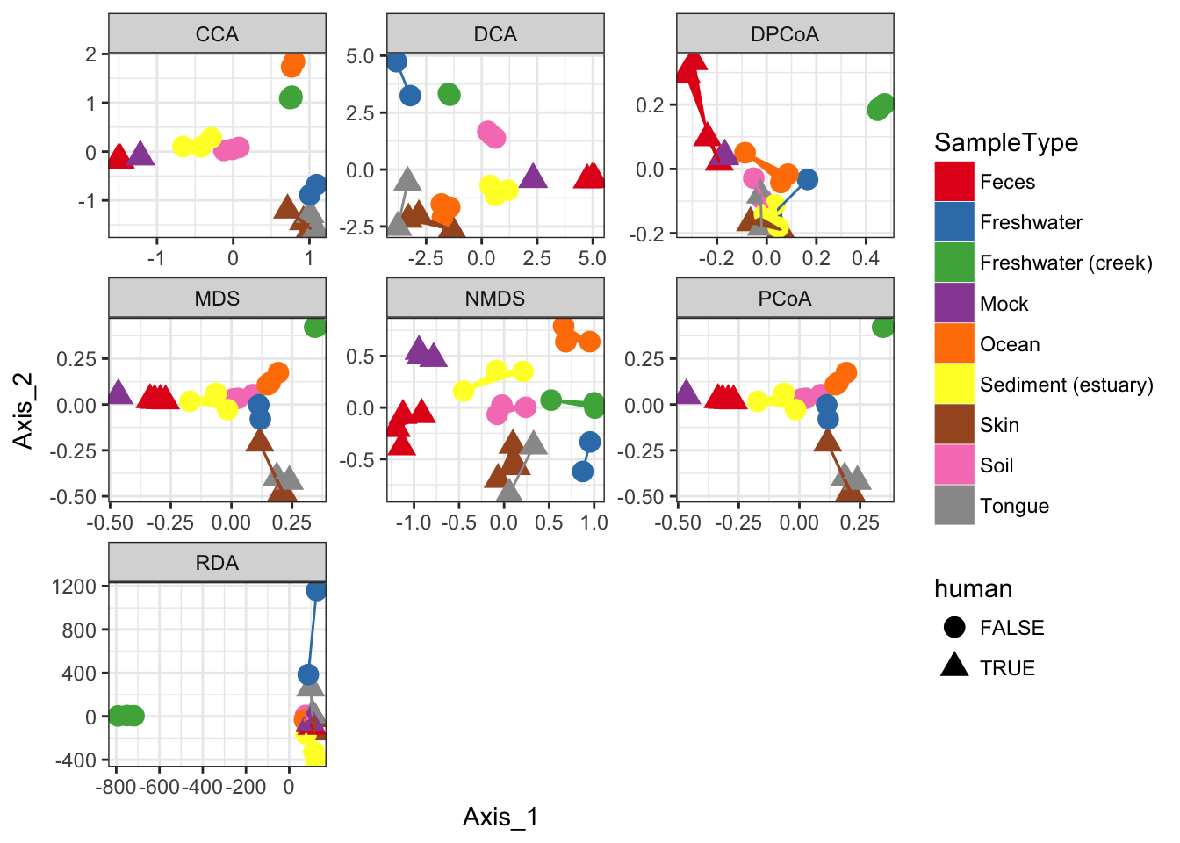
Ordination Metrics (Can Be) Correlated

Slide 24
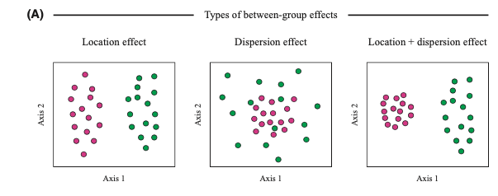
TESTS of BETA DIVERSITY
Paliy & Shankar

Slide 25
TESTS OF BETA DIVERSITY
PERMANOVA
The null hypothesis tested by PERMANOVA is that, under the assumption of exchangeability of the sample units among the groups, H₀: “the centroids of the groups, as defined in the space of the chosen resemblance measure, are equivalent for all groups.” Thus, if H₀ were true, any observed differences among the centroids in a given set of data will be similar in size to what would be obtained under random allocation of individual sample units to the groups (i.e., under permutation).
ANOSIM
The null hypothesis for the ANOSIM test is closely related to this, namely H₀: “the average of the ranks of within‐group distances is greater than or equal to the average of the ranks of between‐group distances,”

Slide 26
PERMUTATIONAL TESTING
REAL DATA
AXIS 2
Within
Group
Between
Group
AXIS 1
Vegetation
No Vegetation

Slide 27
PERMUTATIONAL TESTING
REAL DATA
PERMUTED DATA
AXIS 2
Within
Group
Between
Group
Within
Group
Between
Group
AXIS 2
AXIS 1
AXIS 1
Vegetation
No Vegetation

Slide 28
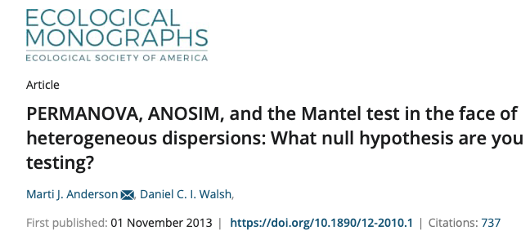
TESTS OF BETA DIVERSITY
Overall, ANOSIM and the Mantel test were very sensitive to heterogeneity in dispersions, with ANOSIM generally being more sensitive than the Mantel test.
In contrast, PERMANOVA ... [was] largely unaffected by heterogeneity for balanced designs.
For unbalanced designs, however, all of the tests were (1) too liberal when the smaller group had greater dispersion and (2) overly conservative when the larger group had greater dispersion, especially ANOSIM and the Mantel test.
For simulations based on real ecological data sets, PERMANOVA was generally, but not always, more powerful than the others to detect changes in community structure
https://esajournals.onlinelibrary.wiley.com/doi/10.1890/12-2010.1

Slide 29

The Importance of Metadata
https://royalsocietypublishing.org/doi/abs/10.1098/rspb.2021.0552

Slide 30
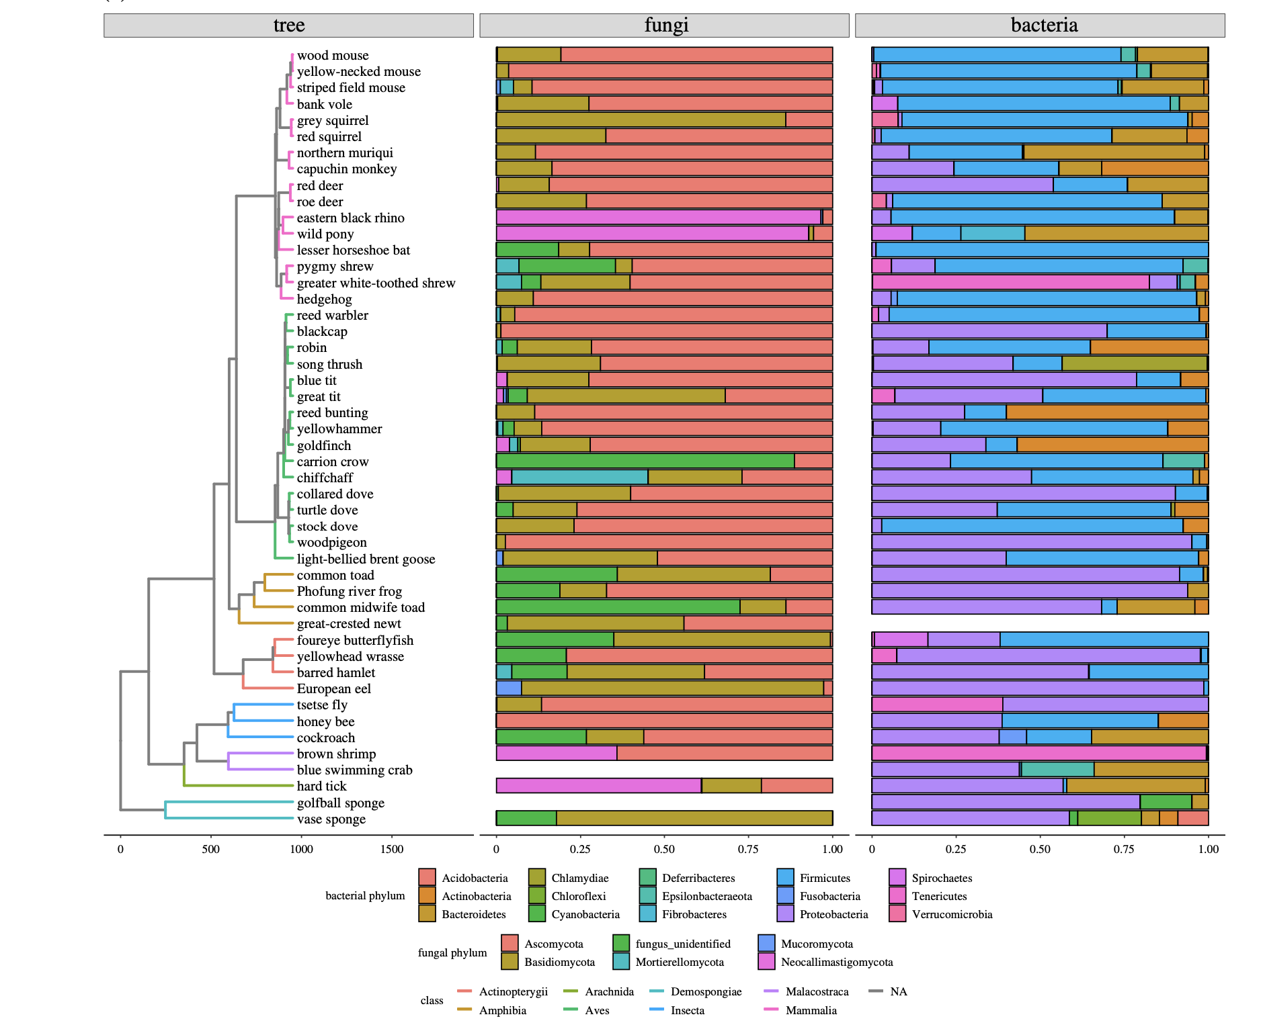
The Importance of Metadata

Slide 31
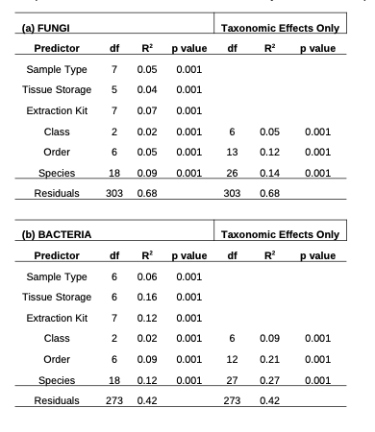
The Importance of Metadata

Slide 32
The Importance of Metadata
Statistical Power and Data Completeness
EXPERIMENTAL DESIGN

Slide 33
The Importance of Metadata
Statistical Power and Data Completeness
DATA COLLECTION

Slide 34
The Importance of Metadata
Statistical Power and Data Completeness
LAB ISSUES

